Slide 1
Amplitude Modulation Contd.

Slide 3
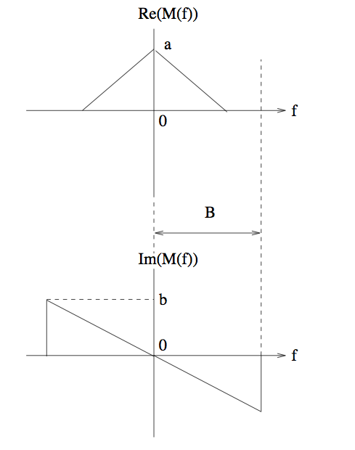
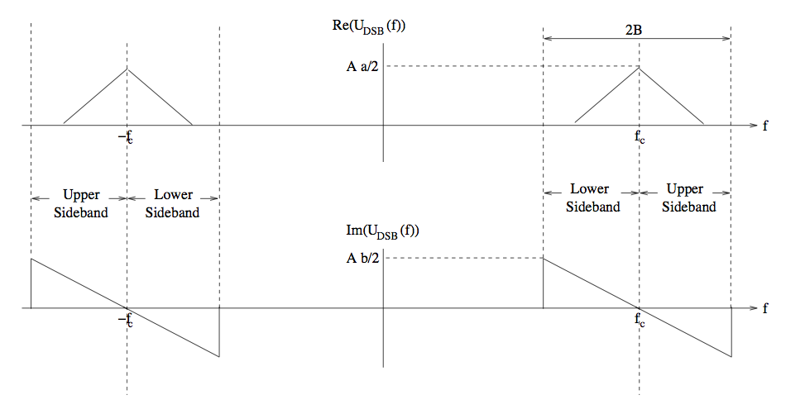
DSB ➔ SSB
DSB signal
Message signal

Slide 4
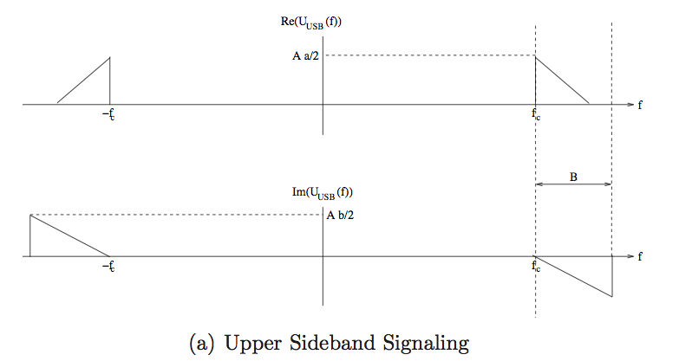
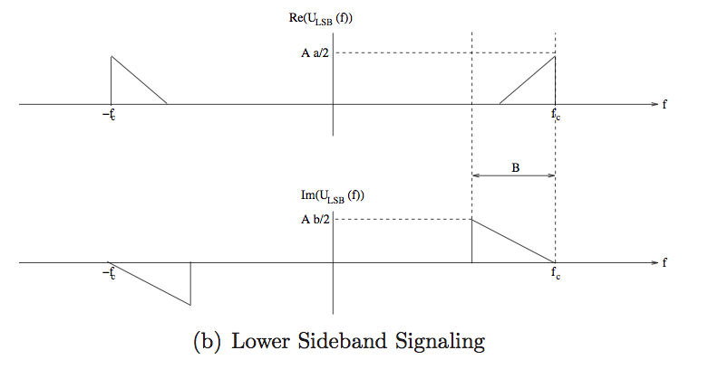
Single sideband (SSB)
Each sideband
has enough
info to reconstruct
the message
(Move in by f_{c}➔
extract I component)

Slide 5
Single Sideband Modulation
In SSB modulation, we send either the upper sideband or the lower sideband of a DSB-SC signal.
Each sideband provides enough information to reconstruct the message.
But how do we physically reconstruct the message from an SSB signal (SSB-demodulation)?

Slide 6
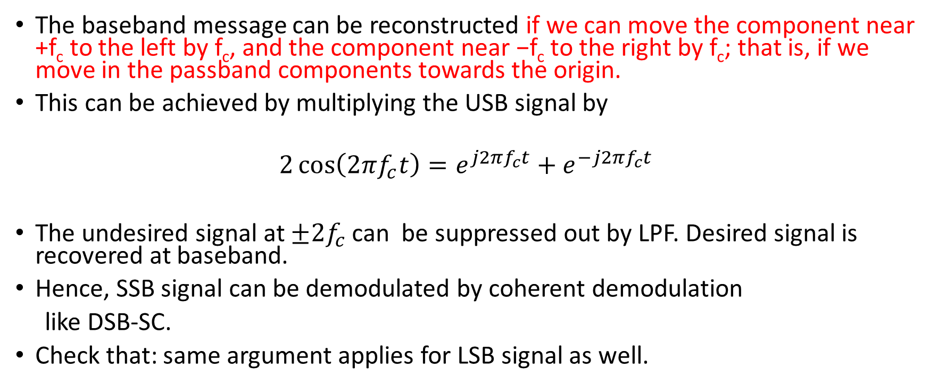
Message is the I component of an SSB signal
The baseband message can be reconstructed if we can move the component near +f_{c} to the left by f_{c}, and the component near −f_{c} to the right by f_{c}; that is, if we move in the passband components towards the origin.
This can be achieved by multiplying the USB signal by
$$2\cos\left(2πf_{c}t\right)=e^{j2πf_{c}t}+e^{−j2πf_{c}t}$$
The undesired signal at $±2f_{c}$ can be suppressed out by LPF. Desired signal is recovered at baseband.
Hence, SSB signal can be demodulated by coherent demodulation
like DSB-SC.
Check that: same argument applies for LSB signal as well.

Slide 7
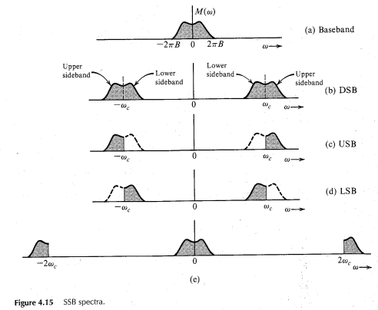

Slide 8
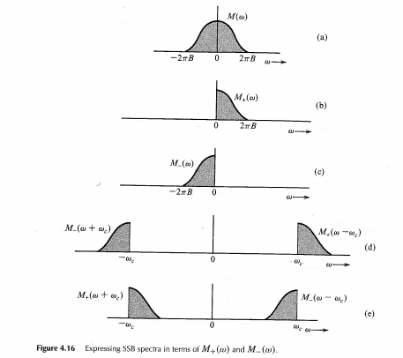

Time-Domain Representation of SSB Signals
$M_{+}$(ω)$=$M(ω)u(ω),
$M_{−}$(ω)$=$M(ω)u(-ω)
Let FT pairs are defined as
$m_{+}(t)↔M_{+}$(ω)
$m_{−}(t)↔M_{−}$(ω)

Slide 9

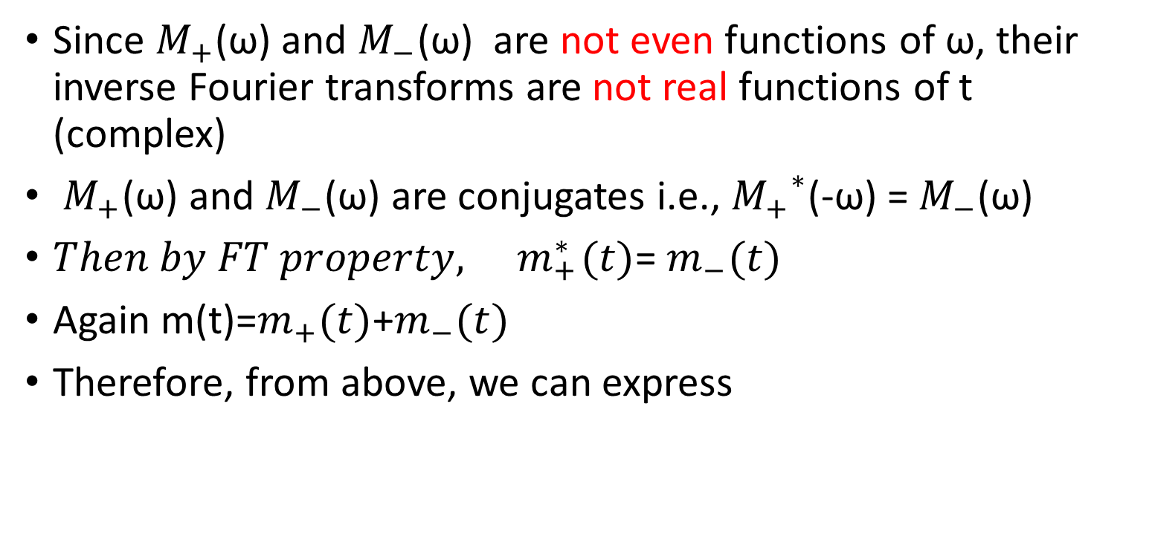
Time-Domain Representation of SSB Signals
Since $M_{+}$(ω) and $M_{−}$(ω) are not even functions of ω, their inverse Fourier transforms are not real functions of t (complex)
$M_{+}$(ω) and $M_{−}$(ω) are conjugates i.e., ${M_{+}}^{∗}$(-ω) =${ M}_{−}$(ω)
$Then by FT property, { m}_{+}^{∗}(t)$= $m_{−}(t)$
Again m(t)=$m_{+}(t)$+$m_{−}(t)$
Therefore, from above, we can express
………………….(4.13)

Slide 10







Determine $m_{h}(t)$
Applying time convolution property and
$m_{h}\left(t\right)=m\left(t\right)∗\frac{1}{πt}$
$m_{h}(t)$ is the Hilbert transform of m(t)

Slide 11

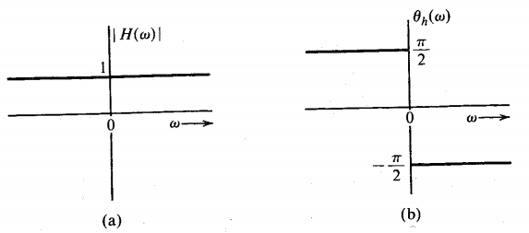
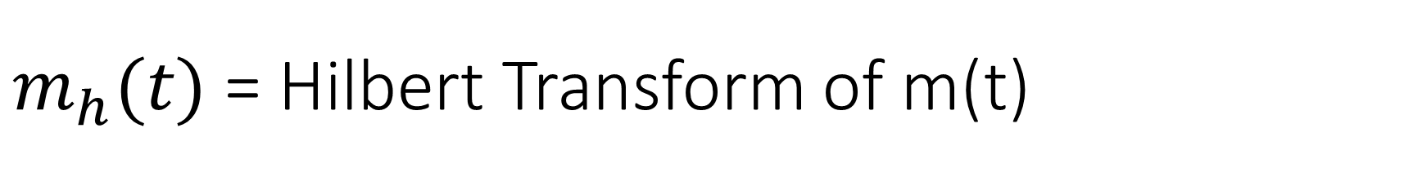
$m_{h}(t)$ = Hilbert Transform of m(t)
If m(t) is passed through a transfer function H(w), then o/p is $m_{h}\left(t\right)=m\left(t\right)∗\frac{1}{πt}, where$

Slide 12
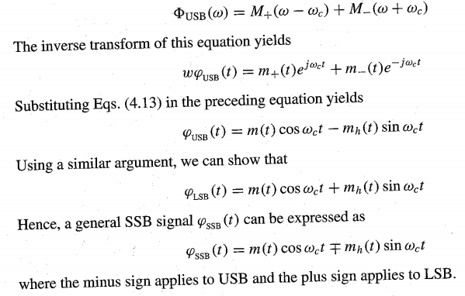







Thus, Hilbert transform is an ideal phase shifter that shifts the phase of every spectral component by $−\frac{π }{2}$
Now express the SSB signal in terms of m(t) and $m_{h}\left(t\right)$.
We see that
$$U_{USB}$$
$$u_{USB}$$
$$u_{USB}$$
$$u_{LSB}$$
$$u_{SSB}$$
$$u_{SSB}$$

Slide 13

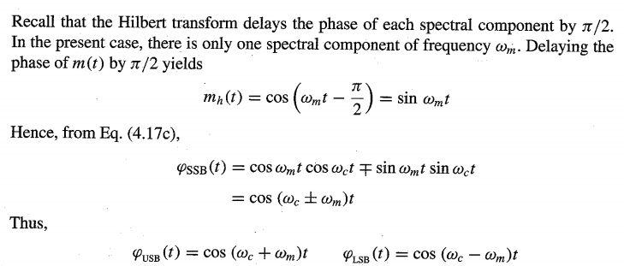

Slide 14
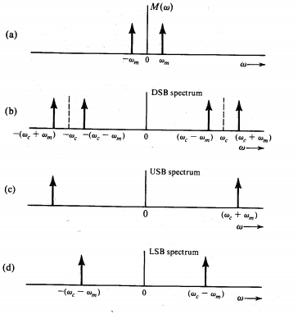

Slide 15
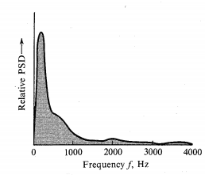

Generation of SSB Signals
Selective filtering method: Use a sharp cut-off filter to eliminate the undesired sideband of DSB-SC. Such an ideal filter is unrealizable.
However, if the baseband spectrum has little power near dc (f=0), we can use gradual cutoff filter to eliminate the undesired sideband.
Example: speech signal freq. component (f<300 Hz) are not so important. We can have a 600 Hz transition region around fc.

Slide 16
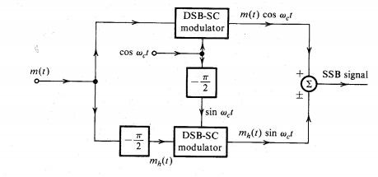
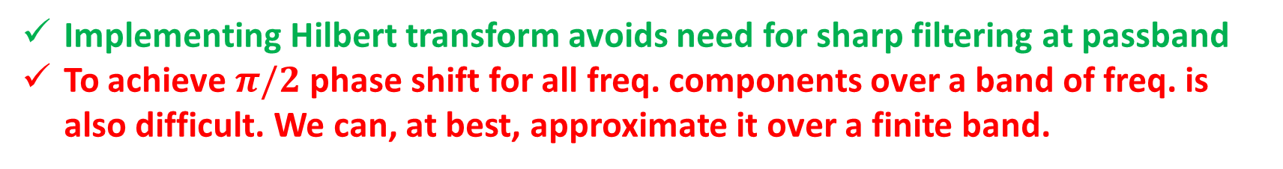
Implementing SSB by Phase-shift method
Implementing Hilbert transform avoids need for sharp filtering at passband
To achieve $π/2$ phase shift for all freq. components over a band of freq. is also difficult. We can, at best, approximate it over a finite band.

Slide 17


Demodulation of SSB-SC Signals
Coherent demodulation to extract I component
Vulnerable to carrier phase offset
Passband received signal, phase offset wrt receiver LO
Complex envelope with respect to receiver LO
I component
attenuation
interference

Slide 18


Envelope Detection of SSB+C Demodulation (non-coherent)
Can add strong carrier component and employ envelope detection
SSB + strong carrier component
Message info preserved in envelope
as long as

Slide 19
Vestigial-sideband (VSB) Modulation
Generation of SSB signal is difficult
Selective filtering method demands dc null in the modulating signal spectrum
An ideal Phase shifter realization is impossible or realizable approximately
Generation of DSB signal is much simpler but it needs twice the message bandwidth
Vestigial-side band also called asymmetric sideband system is a compromise between DSB and SSB.
VSB is similar to SSB, in that it also tries to reduce the transmitted bandwidth relative to DSB, and the transmitted signal is a filtered version of the DSB signal. The idea is to mainly transmit one of the two sidebands, but to leave a vestige (a trace or remnant of something) of the other sideband in order to ease the filtering requirements.

Slide 20
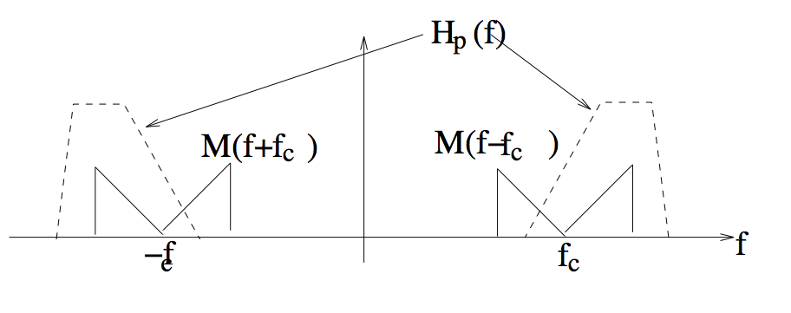
VSB signaling
Easy to realize such a filter
Bandwidth requires 25-33 % extra than SSB signals.

Slide 21
Vestigial-sideband (VSB) Modulation
Consider the DSB-SC signal
2m(t) cos 2πf_{c}t ↔ M(f − f_{c}) +M(f + f_{c})
This is filtered by a passband VSB filter with transfer function H_{p}(f), to obtain the transmitted signal with spectrum
U_{VSB}(f) = H_{p}(f) (M(f − f_{c}) +M(f + f_{c}))

Slide 22



Demodulation
When is is passed through a LPF, we should get the demodulated o/p (Inphase component)
The o/p of LPF after discarding high freq terms

Slide 23
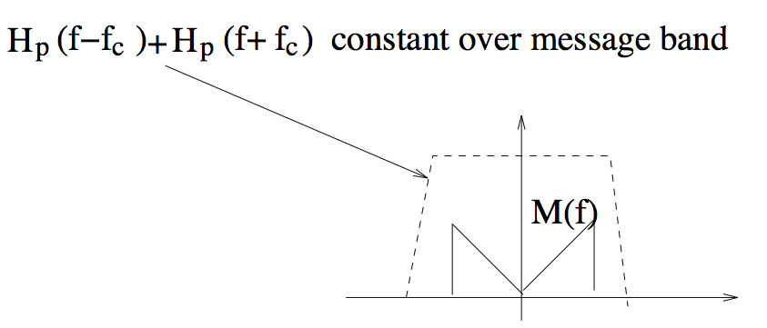
How to choose VSB filter?

Slide 24

Structure of the filter Hp(f): A close Look
Consider time-domain expression for the passband filter impulse response
For perfect demodulation: Hc(f) should be constant over message band [-W,+W]
LPF
LPF

Slide 25
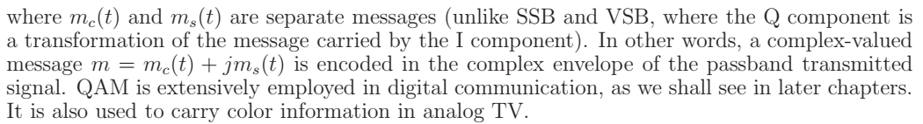
Quadrature Amplitude Modulation (QAM)
Both DSB-SC and AM signal occupy twice the bandwidth required for the baseband.
This disadvantage can be overcomed by transmitting two DSB signals using carriers of same freq. but in phase quadrature.

Slide 26
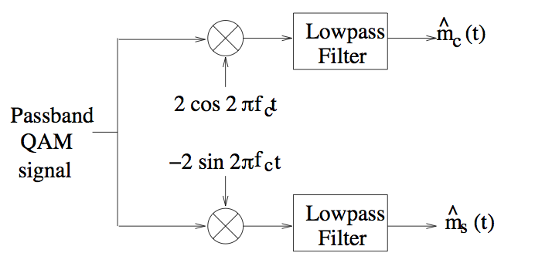
QAM Coherent Demodulation
Both I and Q components carry information
Standard practice in modern digital communication systems

Slide 27

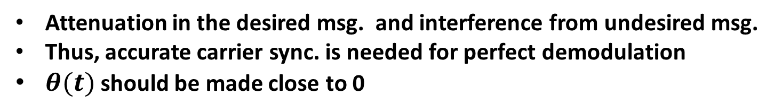
Carrier sync. requirement for QAM
Complex envelope when the Rxd signal has a phase offset $θ(t)$ wrt receiver LO
Effect of rotation on I and Q components
Attenuation in the desired msg. and interference from undesired msg.
Thus, accurate carrier sync. is needed for perfect demodulation
$θ(t)$ should be made close to 0

Slide 28
Example

Slide 29



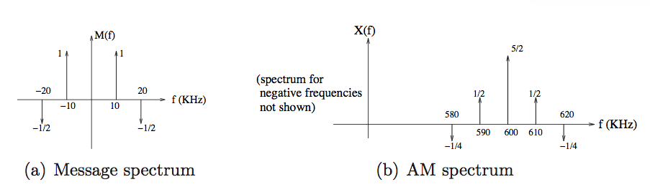
Example 3.2.4
Message signal
AM signal
(time in milliseconds, carrier frequency 600 KHz)
Magnitude spectrum and bandwidth of AM signal?

Slide 30
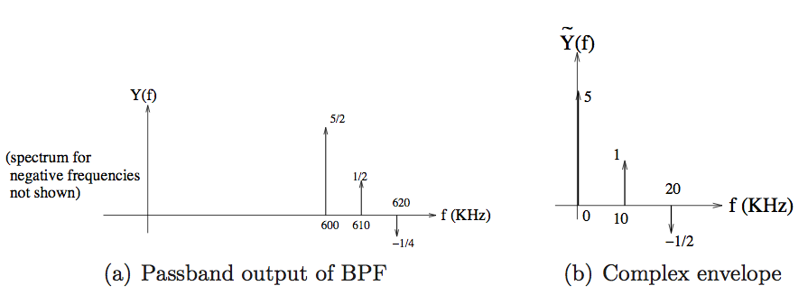


Example 3.2.4 contd.
AM signal passed through an ideal highpass filter with cut-off frequency 595 KHz.
Find explicit time domain expression for Q component of output (relative to 600 KHz
reference)
Easiest to just take inverse Fourier transform of complex envelope
(see text for alternative approaches)
Q component

Slide 31
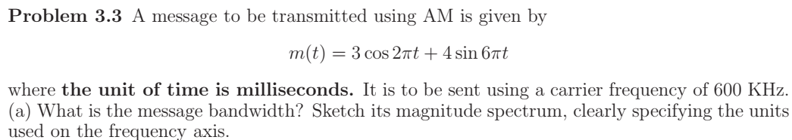
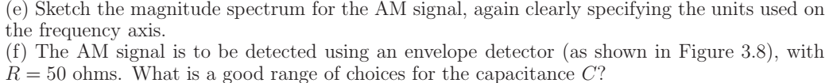

Slide 32
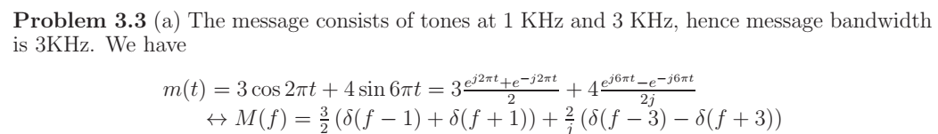
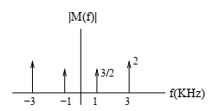

Slide 33
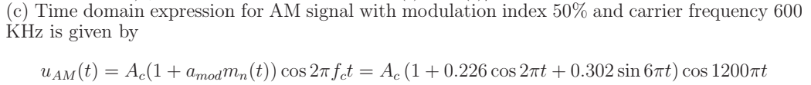
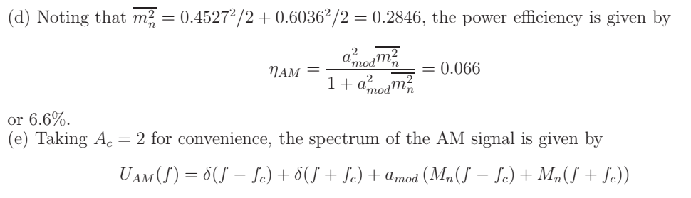

Slide 34
